Slide 1
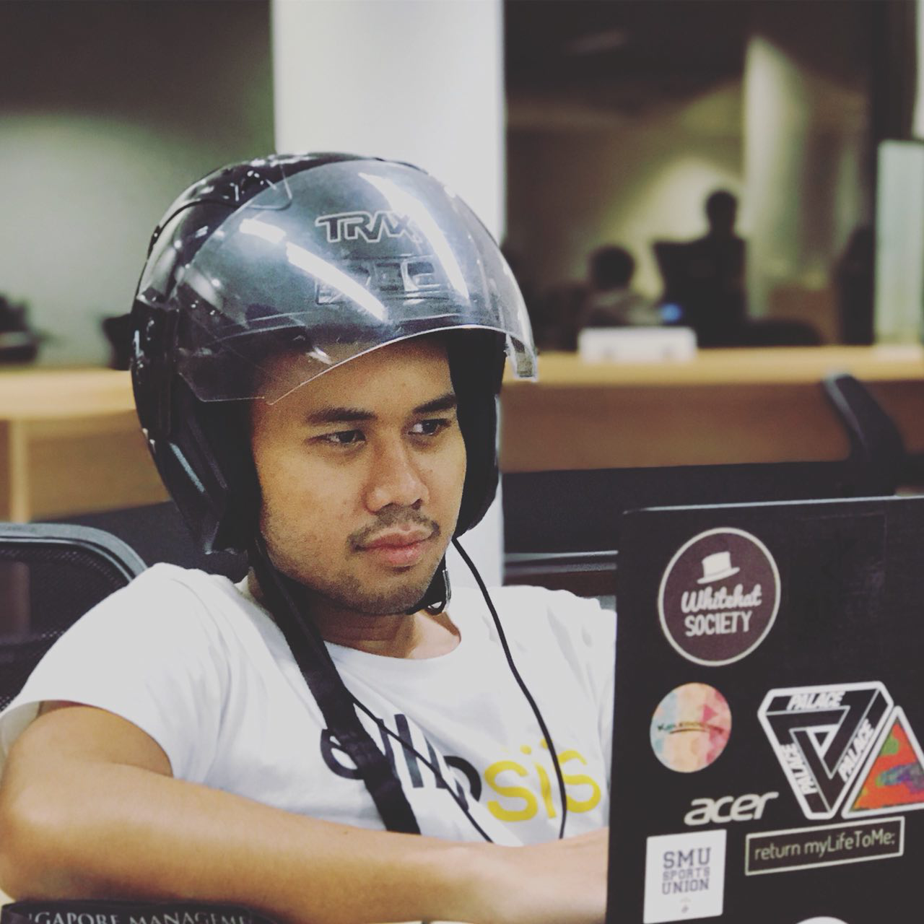
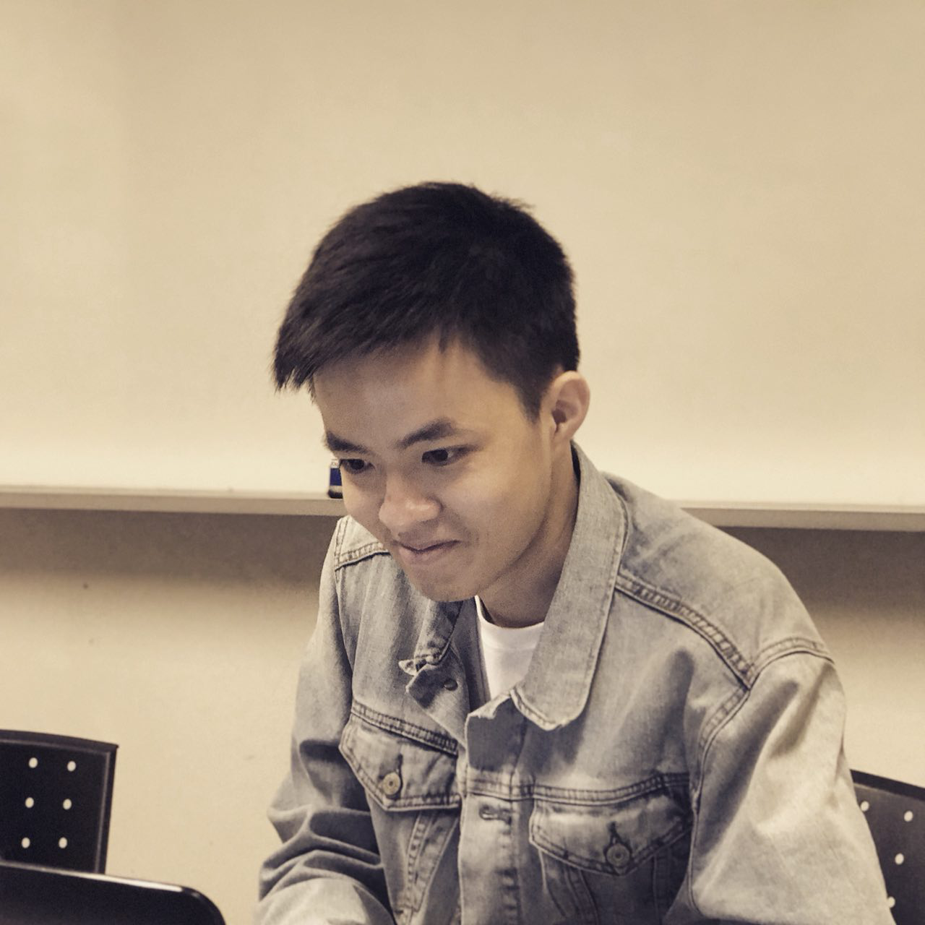
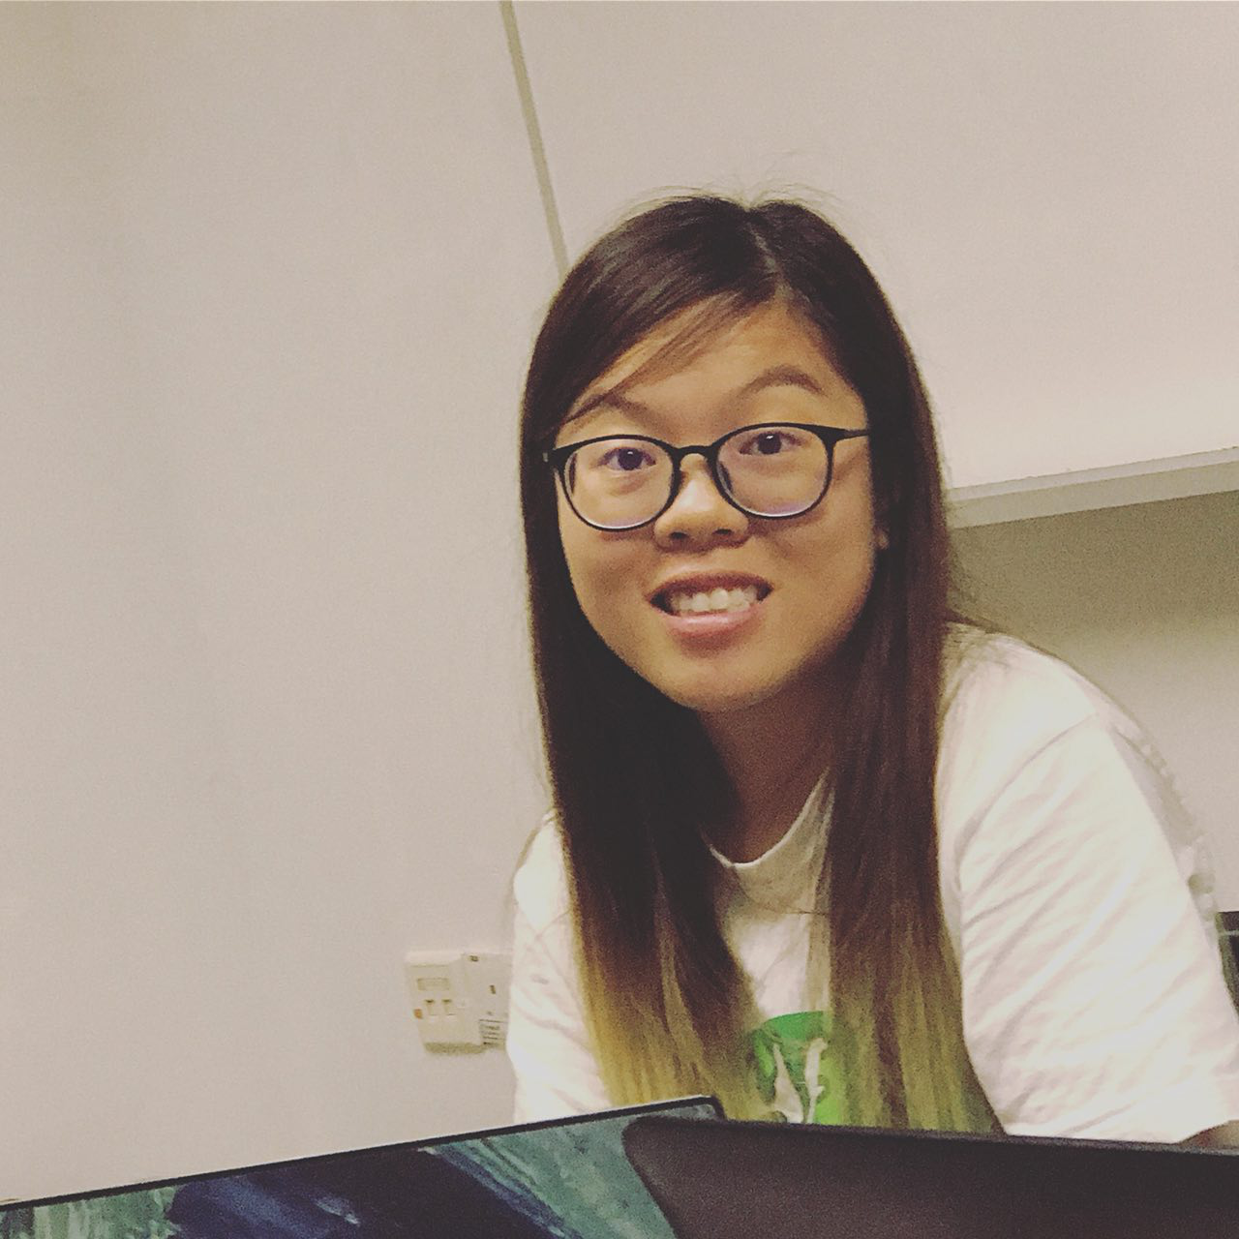



G6T3 – Young Tau Foo
Team Progress after pm review
young.tau.foo
Notes:
Notes:
Please present in this sequence.
You will have 10 minutes for your presentation. Decide wisely on how much time you want to allocate on each section. Make sure to do several dry runs so that you know how long your presentation actually takes.
Not everyone in the team needs to present but the whole team must be present during the presentation.
Everyone is expected to answer questions.
Questions can be directed to the team in general or any particular member of the team.
The order of the presentation will be random.
The presentation time will start whether or not all team members are present.
No formal attire required.
Participation will be judged based on the quality of the questions asked during the Q&A sessions.
Read the additional slides (in eLearn) for additional information about the presentation.

Slide 2
Progress after pm review
Task | Completion Date
Integration of ConnectionManager Class | 5th October 2017
Integration of MVC | 8th October 2017
Bootstrap Integrated with Json | 18th October 2017
Basic Location Report: Top K Next Places | 18th October 2017
Basic Location Report: Top K Popular Places integrated with Json | 22th October 2017

Slide 3
Team Improvements
Familiarization of GIT.
Non-programming documentations were committed and pushed consistently.
Consistent updating of schedule.
Regression testing at the end of each iteration.

Slide 4
Critical Path
Notes:
Show us your critical path.

Slide 5
Iteration Four (Part 1)
BLR
Top k Next Places
BLR
Top k Companions
Review & Goal Setting
Familiarise with JSON
Integrating JSON
3 days
2 days
1 day
1 day
4 days
14 days
Notes:
1 day
Blr next places 2 days
Next companion 1 day
Familiarising with json 1 day
Integrating json 3 days

Slide 6
Iteration Four (Part 2)
UI Design
Testing
Debug
Deploy & test
Debug
3 days
1 day
2 days
1 day
1day
14 days
Notes:
UI design 3 days
Testing
debug
Deploy & test
debug

Slide 7
Iteration Five (Part 1)
Review & Goal Setting
Heatmap
UI Design
Testing & Debugging
Automatic Group Identification
2 days
1 day
2 days
2 days
1 day
11 days

Slide 8
Iteration Five (Part 2)
Deploy & Test
Debugging
UAT Deployment
Buffer
1 day
1 day
2 days
1 day
11 days

Slide 9
Iteration Six
Review & Goal Setting
Resolve UAT Issues
Documentation
UI Design
Final Deployment
Buffer
Presentation Preparation
4 days
1 day
2 days
2 days
2 days
3 days
1 day
11 days
Notes:
3
3
2
-
1

Slide 10
metrics

Slide 11
Task Metric Mitigation Plan
Score (%) | Action
TM < 50 | Gross under-estimation of the effort required. Immediately inform supervisor about the slip within 24 hours. Then use the same mitigation as the category 50 < TM < 90 and seriously consider dropping tasks.
50 < TM <= 90 | Re-estimate the tasks for the future iterations. Decide on critical functionality to focus on in following iteration.
90 < TM <= 110 | Our estimates are fairly accurate, and we are roughly on track.
110 < TM <= 150 | Re-estimate the tasks for the future iterations.
150 < TM | Gross over-estimation of the effort required. Immediately, inform supervisor about the slip within 24 hours. Then use the same mitigation as the category 110 < SM < 150
Formula:
Number of completed tasks / Number of planned tasks

Slide 12
Iteration 3 Task metric
Task Metrics for Iteration 3: 88.2%

Slide 13
Iteration 4 Task metric
Task Metrics for Iteration 4: 100%

Slide 14
Task Metric Calculations
Iteration | Metric Score | Action
3 | 88.2% | Re-estimate the tasks for the future iterations. We decided to focus on completing the Breakdown and Next Places functions and JSON integration for completed functions (Bootstrap and Popular Places). Companions was pushed to the end of Iteration 4’s plan, to allow us to focus on having a suitable demo.
4 | 100% | Our estimates are fairly accurate, and we are roughly on track.

Slide 15
Bug Metric
Iteration | Metric Score | Action
3 | 7 | Planned to solve during debugging time in the next iteration as the bug was discovered late in the iteration and there were other tasks that needed to be prioritised.
4 | 10 | Development was halted and bugs solved during iteration. Companions was pushed back to account for bug solving time.

Slide 16
Risk mitigation plan
S/N | Risk Statement | Consequences | Impact (H/M/L) | Contingency Plan
1 | Hidayat’s laptop malfunctioned during the recess week. | Delayed progress for upcoming pair- programming sessions. | H | Re-install all the necessary software needed for the project and re-clone GIT repository on the new machine. *
2 | Shen Ying and Gerald involved in school election during recess week. | Lack of manpower and heavy workload will be passed on the remaining members. | H | The rest of the members will have to put in extra effort during recess week so that we are able to prevent further delays.
3 | Team members fell sick. | PP session affected, delay in producing output. | M | Other pair will take over the task of the member who is sick.
* As a result, there are 2 users with Hidayat’s name on GitLab (current active user is Hidayatullah)

Slide 17
Manpower Allocation

Slide 18
Work breakdown per member Programming (Coding, Debugging, integration) VS Non Programming (Design, Deployment, Testing)
 | Programming | Non Programming
Denise | Breakdown of Gender, Year and School Debugging of Bootstrap Top K Popular Places Admin Page | Designing of diagrams Test Cases (Bootstrap) PM review preparation Video demo preparation
Gerald | Breakdown of Gender, Year and School Login Bootstrap Debugging of Bootstrap Top K Popular Places Top K Companion (In-progress) | Designing of diagrams Test Cases (Bootstrap) PM review preparation Video demo preparation
Hidayat | Breakdown of Gender, Year and School Top K Popular Places Top K Next Places Integration of ConnectionManager class Integration of MVC Top K Companion (In-progress) | Designing of diagrams PM review preparation Video demo preparation

Slide 19
Work breakdown per member Programming (Coding, Debugging, integration) VS Non Programming (Design, Deployment, Testing)
 | Programming | Non Programming
Shenying | Login Bootstrap + (with JSON) Integration of JSON for Top k Popular Places UI Integration Debugging of all functions Admin Page | Designing of diagrams Test Cases (Top-k popular places) PM review preparation Video demo preparation
Wei Kiat | Top K Next Places Bootstrap with JSON Integration of ConnectionManager class Integration of MVC Integration of JSON for Top k Popular Places UI Integration Debugging of all functions | Designing of diagrams Test Cases (Top-k popular places) PM review preparation Video demo preparation

